Slide 1
AZ-900T0x Learning Path: Review Microsoft Azure and Support
Notes:
Adjust the cover for either AZ-900T00 or AZ-900T01.

Slide 2

Learning Objectives
You will learn the following concepts:
Azure Subscriptions
Subscription options
Planning and Managing Costs
Available products and services
Pricing and TCO calculators
Support Options
Where to go when you have questions
Service Level Agreements
What is an SLA
Calculating your cloud application uptime
Service Lifecycles in Azure
Preview and General Availability features
Notes:
This slide is important. We are telling the learners… This is what I am going to tell you.
We then tell them / show them.
At the end we review what we told them.
Then we give them references for further learning.
Then we say Thanks you where we will then put our closing deck for customer feedback…

Slide 3
Module: Review Azure subscriptions

Slide 4
Review Azure Subscriptions Introduction
Learning objectives:
Understand and describe Microsoft Azure subscriptions and management groups.
Explore different Azure subscription offers.
Review the Azure free account.

Slide 5
Define Azure subscriptions
An Azure subscription provides you with authenticated and authorized access to Azure accounts.
Subscriptions can provide billing and access control boundaries.
An account can have one subscription or multiple subscriptions.
Notes:
Azure subscription offers - https://azure.microsoft.com/en-us/support/legal/offer-details/

Slide 6
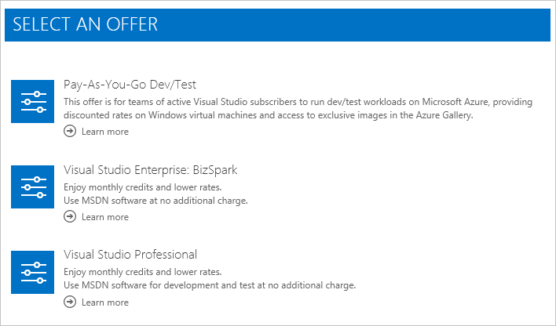
Explore Subscription offers
Free (next slide)
Pay-as-you-go
Enterprise Agreement
Student
An account can have one subscription or multiple subscriptions.
Notes:
Azure subscription offers - https://azure.microsoft.com/en-us/support/legal/offer-details/

Slide 7
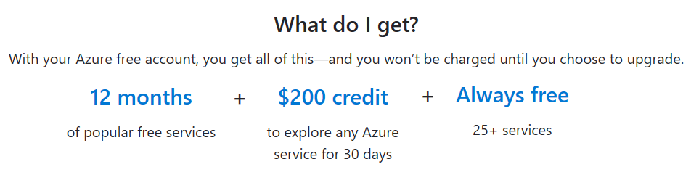
Discuss Azure free account
Provides 12 months of our most popular services, a $200 credit to explore any Azure service for 30 days, and over 25 services are free.
At the end of the trial you can upgrade to pay-as-you-go pricing.
Notes:
Azure free accounts - https://azure.microsoft.com/en-us/free/

Slide 8
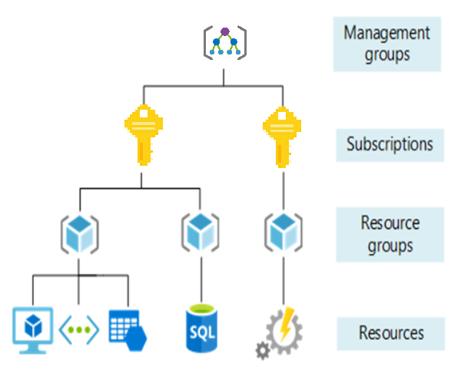
Explore Management Groups
Management groups can include multiple Azure subscriptions.
Subscriptions inherit conditions applied to the management group.
10,000 management groups can be supported in a single directory.
A management group tree can support up to six levels of depth.
Notes:
Management groups - https://docs.microsoft.com/en-us/azure/governance/management-groups/

Slide 9

Knowledge Check Populate with instructions to use the polling tool of your choice
Which one?
A). Azure Portal
B). PowerShell
C). Local Tool
Module: Azure Subscriptions
Use your Smartphones or Mobile Devices
Go to (insert polling app link of your choice) Enter Code: 123-45-678
Please participate in the quiz for this section
Notes:
WWL recommends using polling to be completed for every 7 – 10 slides and preferably at the end of each section. This helps break classes up and adds more interactivity especially for remote classes.
In order to promote interactivity, WWL suggests the use of Mentimeter, Kahoot or a similar polling technology. Please feel free to adjust this slide as needed and populate with the instructions based on the polling tool of your choice.

Slide 10
Summary – Review Azure Subscriptions
We have covered several important topics in this module.
What an Azure Subscription is and how you pick the one right for your business.
You have created an Azure free account and learned how to sign in using that account.
You have seen how billing, subscriptions, and support are managed in Azure.

Slide 11
Module: Planning and managing costs

Slide 12
Planning and Managing Costs Introduction
Learning Objectives:
Explore purchasing Azure products and services.
Define the factors that affect your cost.
Review and use the Azure Pricing Calculator and the Azure TCO Calculator.
List ways of minimizing your costs.

Slide 13
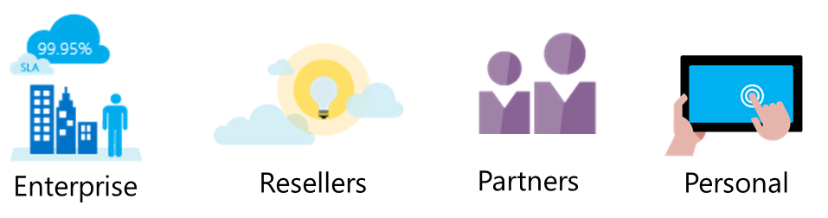
Purchasing Azure products and services
Three main customer types on which the available purchasing options for Azure products and services are contingent are:
Enterprise
Web direct
Cloud solution providers (CSPs)
Personal accounts can also purchase Azure products and services.
Notes:
Azure products and services purchasing options - https://azure.microsoft.com/en-us/pricing/purchase-options/

Slide 14
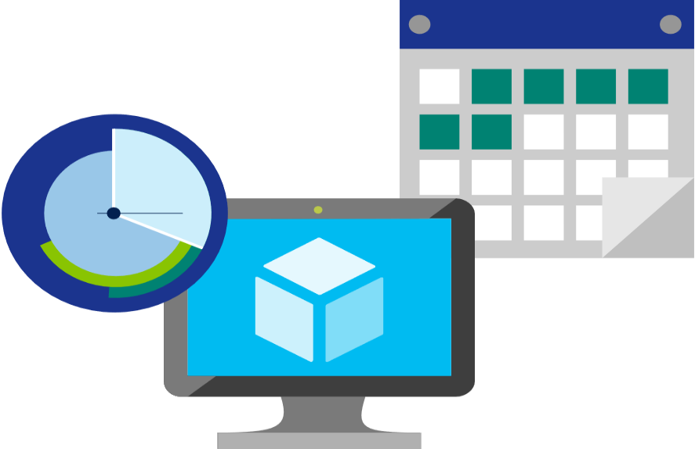
Explore Factors affecting costs
There are three primary factors affecting costs:
Resource Type | Services | Location
Costs are resource-specific, so the usage that a meter tracks and the number of meters associated with a resource depend on the resource type. | Azure usage rates and billing periods can differ between Enterprise, Web Direct, and CSP customers. | The Azure infrastructure is globally distributed, and usage costs might vary between locations that offer Azure products, services, and resources.
Notes:
Azure usage charges - https://docs.microsoft.com/en-us/azure/billing/billing-understand-your-invoice

Slide 15

Identify Zones for Billing Purposes
Bandwidth - data moving in and out of Azure datacenters. Some inbound data transfers are free, such as data going into Azure datacenters. For outbound data transfers—such as data going out of Azure datacenters—pricing is based on Zones.
Zone 1 | West US, East US, West Europe, and others.
Zone 2 | Australia Central, Japan West, Central India, and others.
Zone 3 | Brazil South only.
DE Zone 1 | Includes Germany Central and Germany Northeast.
Notes:
Point out that the Zone referred to here, is different from Availability Zone. Availability Zones being an Azure service providing High availability, whereas Zones in the context of billing are geographical entities, used for data transfer pricing between defined geographical areas called Zones.
Zone is a geographical grouping of Azure Regions for billing purpose. Data transfer pricing is based on the Zones.

Slide 16
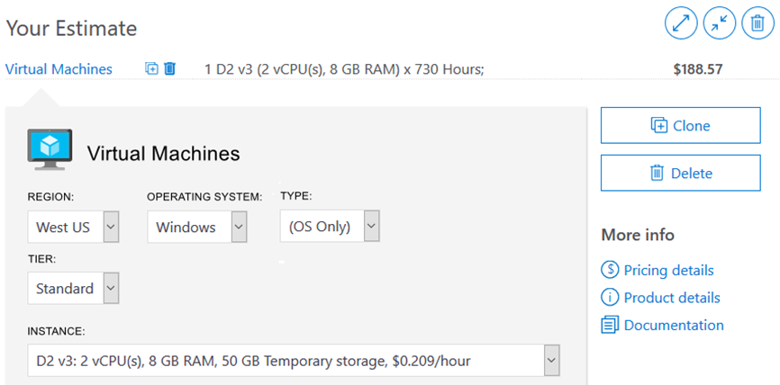
Explore Pricing calculator
Provides a detailed estimate of the costs associated with your infrastructure configuration.
Notes:
Note: The pricing calculator provides estimates, and not actual price quotes. Actual prices can vary depending upon the date of purchase, the payment currency, and the type of Azure customer.

Slide 17
Walkthrough – Use the Azure Pricing Calculator
Use the Azure Pricing Calculator to generate a cost estimate for an Azure virtual machine and related network resources.
Configure the pricing calculator.
Review the pricing estimate.

Slide 18
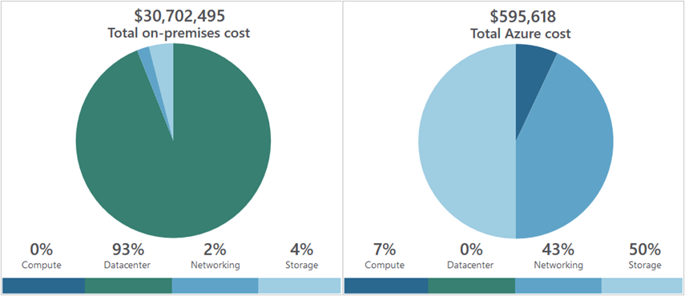
Explore Total cost of ownership calculator
A tool to estimate cost savings you can realize by migrating to Azure.
A report compares the costs of on-premises infrastructures with the costs of using Azure products and services in the cloud.
Notes:
TCO calculator - https://azure.microsoft.com/en-us/pricing/tco/calculator/

Slide 19
Walkthrough – Use the Azure TCO Calculator
Use the Total Cost of Ownership (TCO) Calculator to generate cost comparison report for an on-premises environment.
Configure the TCO calculator.
Review the results and save a copy.

Slide 20
Explore Minimizing costs
Perform
Perform cost analyses. Use the Azure Pricing and TCO calculators.
Monitor
Monitor usage with Azure Advisor. Implement recommendations.
Use
Use spending limits. Use via free trial customers and some credit-based Azure subscriptions.
Use
Use Azure Reservations and Azure Hybrid Benefit (HUB).
Choose
Choose low-cost locations and regions. If possible, use low-cost locations.
Keep
Keep up-to-date with the latest Azure customer and subscription offers.
Apply
Apply tags to identify cost owners. Identify usage owners with tags.

Slide 21
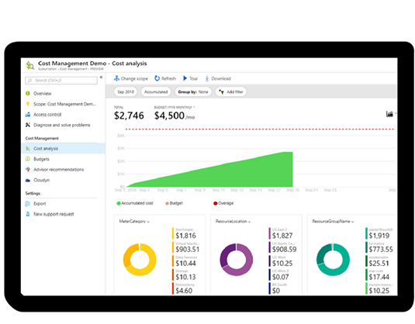
Define Azure Cost Management
Reporting
Data enrichment
Budgets
Alerting
Recommendations
Notes:
Note: For more information about Cost Management, refer to https://azure.microsoft.com/en-us/services/cost-management/

Slide 22

Knowledge Check Populate with instructions to use the polling tool of your choice
Which one?
A). Azure Portal
B). PowerShell
C). Local Tool
Module: Planning and Managing Costs
Use your Smartphones or Mobile Devices
Go to (insert polling app link of your choice)
Enter Code: 123-45-678
Please participate in the quiz for this section
Notes:
WWL recommends using polling to be completed for every 7 – 10 slides and preferably at the end of each section. This helps break classes up and adds more interactivity especially for remote classes.
In order to promote interactivity, WWL suggests the use of Mentimeter, Kahoot or a similar polling technology. Please feel free to adjust this slide as needed and populate with the instructions based on the polling tool of your choice.

Slide 23
Summary – Planning and Managing Costs
In this module you learned about topics like:
How to purchase Azure products and services.
Which factors affect your cost and how you might manage that cost.
How to use the Azure Pricing Calculator and the Azure TCO Calculator to predict spend.
And several ways to minimize your costs.

Slide 24
Module: Azure support options

Slide 25
Azure Support Options Introduction
Learning objectives:
Review the available support plans.
List of other channels to get Azure support.
Explore the capabilities of the Azure Knowledge Center.
Create a support request.

Slide 26
Explore Support plan options
Every Azure subscription includes free access to billing and subscription support, Azure products and services documentation, online self-help documentation, white papers, and community support forums.
 | Basic | Developer | Standard | Professional Direct
Scope | Available to all Microsoft Azure accounts | Trial and non-production environments | Production workload environments | Business-critical dependence
Technical Support |  | Business hours access to Support Engineers via email | 24x7 access to Support Engineers via email and phone | 24x7 access to Support Engineers via email and phone
Notes:
For more information about Azure support options, refer to https://azure.microsoft.com/en-us/support/plans/

Slide 27





Explore Alternative support channels
Microsoft Developer Network (MSDN) Azure Forums
Stack Overflow
Server Fault
Microsoft Azure general feedback
@AzureSupport
Notes:
For more information about alternative Azure support channels, refer to https://azure.microsoft.com/en-us/support/community/

Slide 28
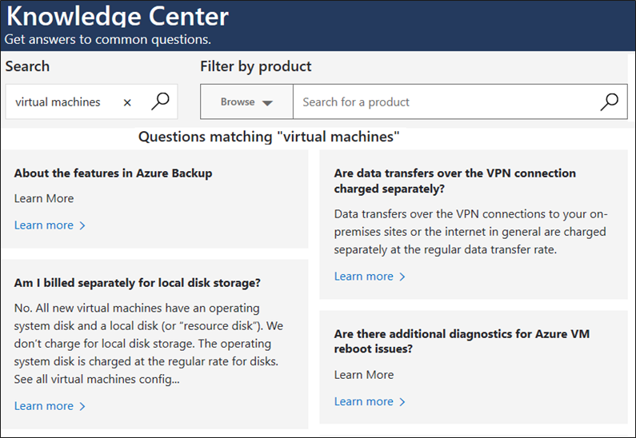
Explore Knowledge Center
A searchable database that contains support questions and answers from a community of Azure experts, developers, customers, and users.
Notes:
For more information about alternative Knowledge Center, refer to https://azure.microsoft.com/en-us/resources/knowledge-center/

Slide 29
Walkthrough – Open a Support Request
View available support plan options and then practice creating and monitoring a new support request.
View available support plan options and create a new technical support request.
Create a billing support request.

Slide 30
Knowledge Check Populate with instructions to use the polling tool of your choice
Which one?
A). Azure Portal
B). PowerShell
C). Local Tool
Module: Azure Support Options
Use your Smartphones or Mobile Devices
Go to (insert polling app link of your choice) Enter Code: 123-45-678
Please participate in the quiz for this section
Notes:
WWL recommends using polling to be completed for every 7 – 10 slides and preferably at the end of each section. This helps break classes up and adds more interactivity especially for remote classes.
In order to promote interactivity, WWL suggests the use of Mentimeter, Kahoot or a similar polling technology. Please feel free to adjust this slide as needed and populate with the instructions based on the polling tool of your choice.

Slide 31
Summary – Azure Support Options
In this module we learned about the various support options you have with Azure. We explored:
The available support plans.
Other channels to get Azure support.
The capabilities of the Azure Knowledge Center.
Created a support request.

Slide 32
Module: Azure Service Level Agreements (SLAs)

Slide 33
Azure Service Level Agreements (SLAs) Introduction
Learning objectives:
Define what a Service Level Agree (SLA) is.
Review the various types and levels of SLAs.
Explore composite SLAs
Review how you can calculate your SLA based on components you choose.

Slide 34
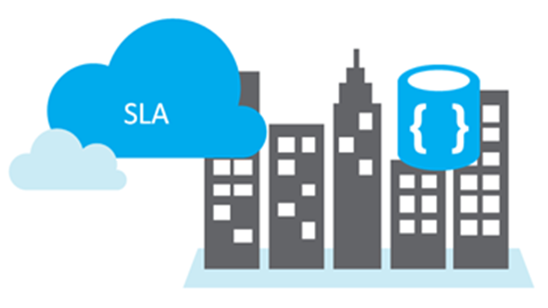
Define Service Level Agreements (SLAs)
SLAs document the specific terms that define Azure performance standards.
SLAs define Microsoft’s commitment to an Azure service or product.
Individual SLAs are available for each Azure product and service.
SLAs also define what happens if a service or product fails to meet the designated availability commitments.

Slide 35
Explore SLAs for Azure products and services
Performance targets are expressed as uptime and connectivity guarantees.
Performance-targets range from 99.9% (three nines) to 99.99% (four nines).
If a service fails to meet the guarantees, a percentage of the monthly service fees can be credited to you.
SLA | Downtime per month | Downtime per year
99.9% | 43.2 minutes | 8.76 hours
99.95 | 21.6 minutes | 4.38 hours
99.99 | 4.32 minutes | 52.56 minutes
Notes:
You might want to browse to some SLA’s directly https://azure.microsoft.com/en-us/support/legal/sla/summary/ and explore one or two as examples.

Slide 36
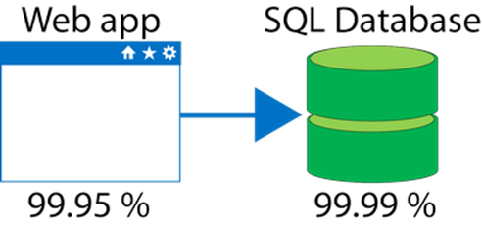
Define Composite SLAs
If the App Service has a 99.95% SLA, and the Azure SQL Database has a 99.99% SLA, what is the composite SLA for your application?
Notice the composite SLA is lower than the individual SLAs.
Improve the SLA by creating independent fallback paths.
Composite SLA
.9995 * .9999
= 99.94%

Slide 37
Define Application SLAs
Customers should determine what SLA is needed for their application:
Know your workload requirements and usage patterns.
Design for resiliency and availability.
Establish availability metrics — mean time to recovery (MTTR) and mean time between failures (MTBF).
Establish recovery metrics — recovery time objective and recovery point objective (RPO).
Implement resiliency strategies.
Build in availability requirements.
Notes:
For more information about improving application SLAs, refer to https://docs.microsoft.com/en-us/azure/architecture/resiliency/

Slide 38
Walkthrough – Calculate a Composite SLA
Determine services SLA uptime percentages and then calculate the application composite SLA uptime percentage.
Determine the SLA uptime percentage values for an application.
Calculate the Application Composite SLA percentage uptime.

Slide 39
Walkthrough - Calculate a Composite SLA
Determine services SLA uptime percentages and then calculate the application composite SLA uptime percentage.
Determine the SLA uptime percentage values for an application.
Calculate the Application Composite SLA percentage uptime.

Slide 40
Knowledge Check Populate with instructions to use the polling tool of your choice
Which one?
A). Azure Portal
B). PowerShell
C). Local Tool
Module: Service Level Agreements (SLAs)
Use your Smartphones or Mobile Devices
Go to (insert polling app link of your choice)
Enter Code: 123-45-678
Please participate in the quiz for this section
Notes:
WWL recommends using polling to be completed for every 7 – 10 slides and preferably at the end of each section. This helps break classes up and adds more interactivity especially for remote classes.
In order to promote interactivity, WWL suggests the use of Mentimeter, Kahoot or a similar polling technology. Please feel free to adjust this slide as needed and populate with the instructions based on the polling tool of your choice.

Slide 41
Summary – Azure Service Level Agreements (SLAs)
Across this module we have explored the Service Level Agreements available in Azure. You should now be able to
Define what a Service Level Agree (SLA) is.
Review the various types and levels of SLAs.
Explore composite SLAs.
Calculate your SLA based on components you choose.

Slide 42
Module: Service lifecycle in Azure

Slide 43
Service Lifecycles in Azure Introduction
Learning objectives:
Define what public and private-preview features are.
Explore how you can access these features.
Review what general availability of a feature is.
Preview a few of the upcoming features.

Slide 44
Public and private preview features
Microsoft offer previews of Azure features for evaluation purposes.
With Azure previews, you can test beta and other pre-release features, products, services, software, and regions.
Private Preview |  | Public Preview
Azure feature available to certain Azure customers for evaluation purposes. |  | Azure feature available to all Azure customers for evaluation purposes.
Notes:
Some preview features are not covered by customer support.
For more information about Azure Previews, visit https://azure.microsoft.com/en-us/services/preview/

Slide 45
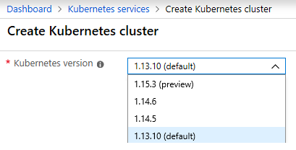
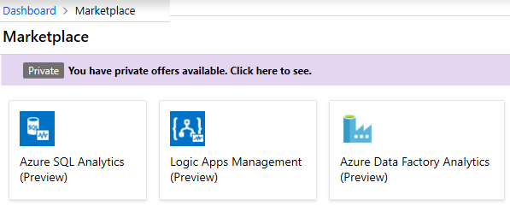
Accessing preview features
Preview new functionality and features for an existing service.
Preview new services.
Notes:
✔️ Although you may be using the Azure service in production, the preview feature or functionality may not yet be ready for production deployments. Make sure you are aware of any limitations around its use before deploying to production.

Slide 46
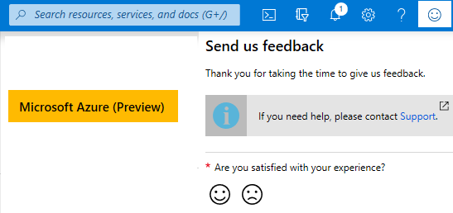
Accessing Azure Portal preview
Access the Azure Portal (Preview) - https://preview.portal.azure.com.
Provide feedback on new features such as full-screen blades, performance, navigation, notifications, and accessibility improvements.
Check out the Azure Portal feedback forum.
Notes:
✔️ Azure Portal feedback forum - https://feedback.azure.com/forums/223579-azure-portal

Slide 47
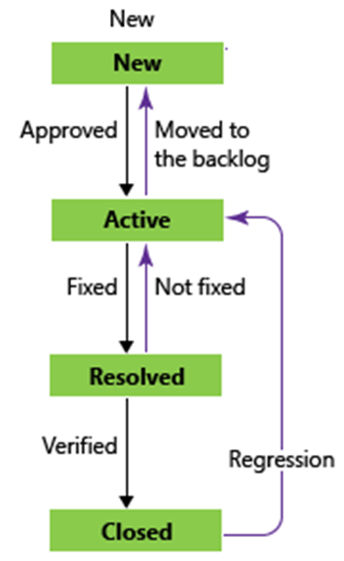
General Availability
New features are evaluated and tested.
Feature bugs go through a lifecycle of new, active, resolved, and fixed.
General availability provides successfully tested features to all Azure customers.
Azure blog announcements is a good source of information.
Notes:
✔️ Learn about updates and new product features on the Azure announcements blog - https://azure.microsoft.com/en-us/blog/topics/announcements/.

Slide 48
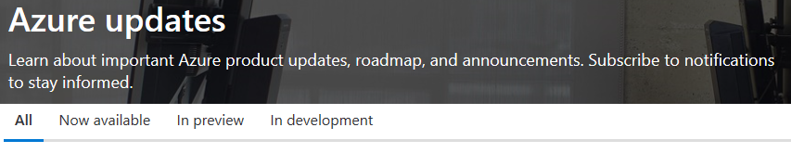
Monitoring service and feature updates
Azure updates provides information about the Azure products, services, and features, and product roadmaps, and availability.
View details about all Azure updates and their status.
Browse and search for updates.
Subscribe to Azure update notifications by RSS.
Notes:
For more information about Azure updates, refer to https://azure.microsoft.com/en-us/updates/

Slide 49
Walkthrough – Access Azure Preview features
Access and identify Azure preview services and features and view the latest Azure updates information.
Access preview services and features.
Review the Azure updates page.

Slide 50
Knowledge Check Populate with instructions to use the polling tool of your choice
Which one?
A). Azure Portal
B). PowerShell
C). Local Tool
Module: Service Lifecycles in Azure
Use your Smartphones or Mobile Devices
Go to (insert polling app link of your choice) Enter Code: 123-45-678
Please participate in the quiz for this section
Notes:
WWL recommends using polling to be completed for every 7 – 10 slides and preferably at the end of each section. This helps break classes up and adds more interactivity especially for remote classes.
In order to promote interactivity, WWL suggests the use of Mentimeter, Kahoot or a similar polling technology. Please feel free to adjust this slide as needed and populate with the instructions based on the polling tool of your choice.

Slide 51
Summary – Service Lifecycle in Azure
We have covered lots of ground in this module.
You have learned to define what public and private-preview features are.
You explored how you can access these features.
You reviewed what general availability of a feature is.
You saw a preview of a few of the upcoming features.
However, this tour is just the beginning. Azure has so much to offer you, no matter what role you play in your organization.

Slide 52
Learning Path review
Notes:
As you have time, cover the module review questions in the student materials.

